Slide 1











.NET Conference 2023

Slide 2


Output Caching ❤️ Redis
Estendere e scalare il nuovo meccanismo di caching di .NET 7
{
"Name": "Fabio Spaziani",
"Role": "Junior Architect @ Blexin",
}

Slide 3
SPONSOR

Slide 4
Agenda

Slide 5





It was a simple web application...
https://store.asroma.com/
GET /items?type=away.kit
https://api.store.asroma.com
SELECT *
FROM Items
WHERE Type = ‘away.kit’
Database

Slide 6


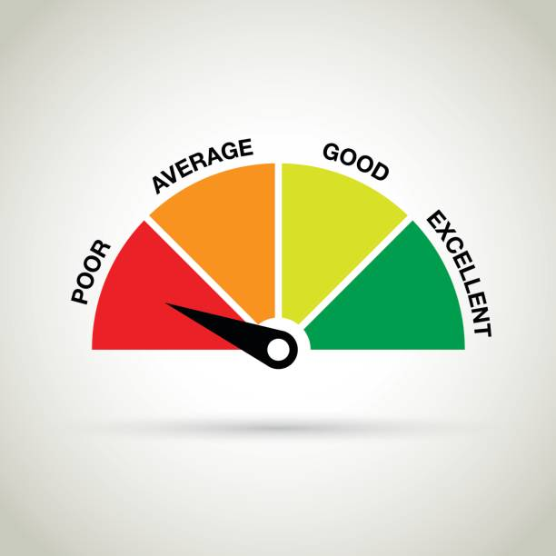
Until...
https://store.asroma.com/
GET /items?type=away.kit
https://api.store.asroma.com
SELECT *
FROM Items
WHERE Type = ‘away.kit’
Database
25/05/2022

Slide 7

Results are obvious...

Slide 8

The solution: CACHING !
NO CACHING
CACHING
SELECT *
FROM Items
WHERE Id = 1
GET /items/1
GET /items/1
Cache Content
GET /items/1
GET /items/1
CACHE
Key | Value
items/1 | {"name": ...}
Key | Value
GET /items/1
GET /items/1
DATA CACHING
In computing, a cache is a high-speed data storage layer which stores a subset of data, typically transient in nature, so that future requests for that data are served up faster than is possible by accessing the data’s primary storage location. Caching allows you to efficiently reuse previously retrieved or computed data.

Slide 9

What if we scale horizontally?
Local Cache BE-01
BE-01
X
Key | Value
Key | Value
items/1 | {"name": ...}
Higher Complexity
🔥
GET /items
SPA Application
Load Balancer
Remote Cache
GET /items
🔥
Centralized
GET /items
X
GET /items
Key | Value
🔥
Key | Value
items/1 | {"name": ...}
Avoid Cold Start
BE-02
Local Cache BE-02

Slide 10
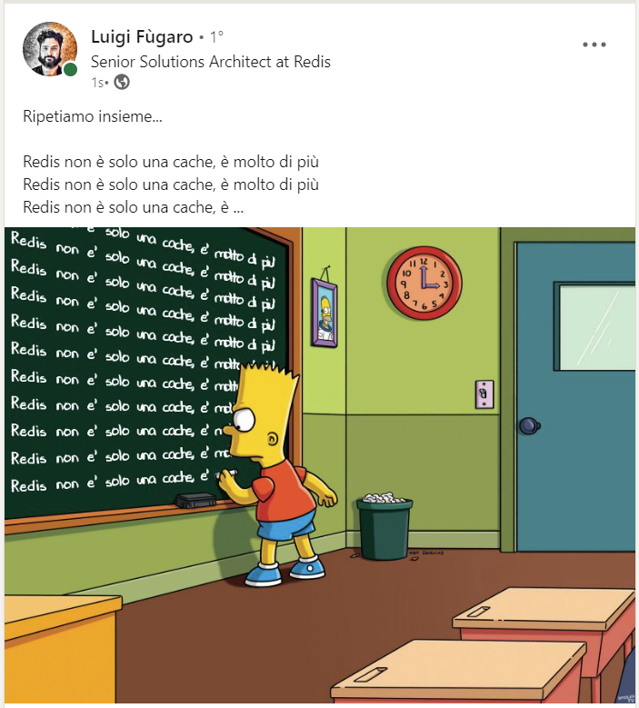

Entering Redis..
Redis is an open source (BSD licensed), in-memory data structure store used as a database, cache, message broker, and streaming engine.

Slide 11
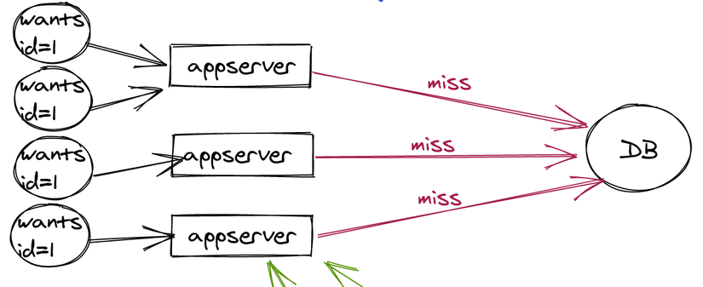
All that glitters is gold?
STALE CACHE
CACHE STAMPEDE
DISTRIBUTED CACHING
Ore: 10:00
Ore: 10:00
FE
GET /items
GET /items
🔥
Key | Value
Key | Value
items/1 | {"name": ...}
Ore: 10:00
GET /items
GET /items
Ore: 10:02
GET /items
Key | Value
GET /items
🔥
Ore: 10:00
Ore: 10:05
GET /items
BE-02
BE-01
POST /items
X
🔥
X
🔥
🔥
Ore: 10:06
?
Expiration
GET /items
Key | Value
Key | Value
Key | Value
items | [{"name": ...}]
Key | Value
items | [{"name": ...}]
Cache Busting

Slide 12


.NET Core Caching – Where?
MemoryCache : IMemoryCache
Performing
Volatile
Local
IFusionCache
IDistributedCache
NCache.Microsoft.Extensions.Caching.OpenSource
Microsoft.Extensions.Caching.StackExchangeRedis
ZiggyCreatures.FusionCache

Slide 13
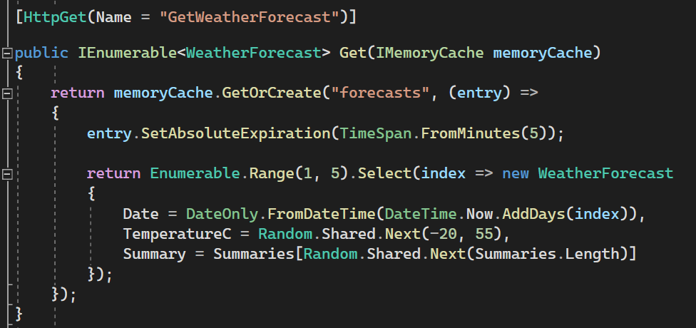
.NET Core Caching – Manual caching
Plumbing
Usage in a controller
Customizable
Cache Key
Item Factory
Different layer
Boilerplate

Slide 14
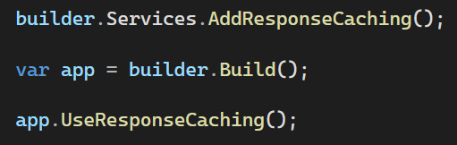
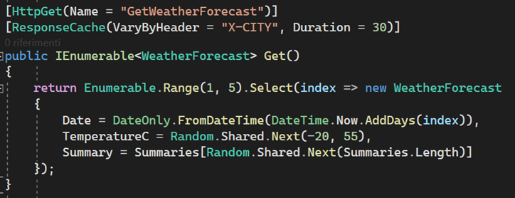
ASP.NET Core – Response Caching
Plumbing
Easy to use
Usage in a controller
General Purpose
Standards Compliant
Standards Compliant
In Memory

Slide 15
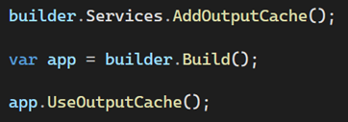
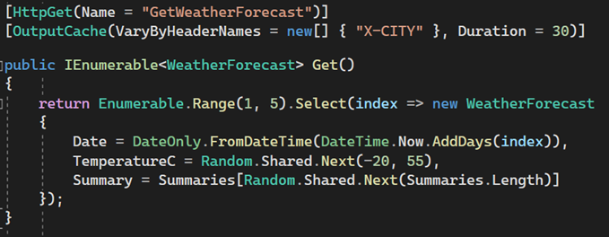
ASP.NET Core – Output Caching
.NET
7
Plumbing
Usage in a controller
Easy to use
Extensible

Slide 16
Demo
«Talk is cheap, show me the code»

Slide 17

Amazing results !
Caching
Caching in ASP .NET
Output Caching
Output Caching ❤️ Redis
❤️
.NET
7

Slide 18


{
"Name": "Fabio Spaziani",
"Role": "Junior Architect@ Blexin",
"Mail": "fabio.spaziani@blexin.com"
"GithubProfile": "https://github.com/fabio-sp"
}

